Slide 1


MIAD
Maestría
en Inteligencia Analítica de Datos

Slide 2



MIAD
Addison Wesley Longman
Maestría
en Inteligencia Analítica de Datos
Sesión sincrónica
Ejercicio semana 2

Slide 3



It was July 1997 and Mark Roth, manager of business books at Addison Wesley Longman, was facing a bit of a dilemma. He was about to present his 1998 fiscal year new book budget and had three new marketing books in his portfolio. One of them, Marketing Engineering, was a bit different from the other two. It did not currently have a large natural market but might ultimately be a big winner, he thought, if it were promoted properly. His main question was – how should he prioritize the promotional resources for the three new books?
The college division of AWL markets books to colleges and universities throughout the world. Its main promotional resources are sampling, brochures, direct mail, exhibitions (primarily at academic meetings) and direct selling to professors. The U.S. college division sales force includes over 200 individuals, each of whom specializes in an academic specialty (business, science, humanities) and works in a regional territory, servicing several dozen schools. AWL managers believe that their sales force is particularly important in encouraging instructors to consider and adopt new textbooks, and they use their sales force as a key tool in their product introduction mix.
The New Marketing Texts
The three new marketing texts that AWL was introducing in the summer of 1997 were:
Advertising and Sales Promotion Strategy by Gerard J. Tellis.
Analysis for Strategic Marketing by Vithala R. Rao and Joel H. Steckel.
Marketing Engineering by Gary L. Lilien and Arvind Rangaswamy.

Slide 4
The Marketing Engineering book was a bit different from others in that it included two volumes plus a CD with 26 software packages that could be applied immediately to both classroom and prototype professional business problems. Both Mark and the authors felt that the AWL selling effort could make a critical difference in the acceptance of the book, especially in the short run.
The New Marketing Book Promotional Challenge
As Mark was finalizing his proposal, he determined that one Marketing Engineering tool might be appropriate for his problem: the GE/McKinsey approach.
Applying the GE Approach
In consultation with his planning staff, Mark came up with the following factors for the components of the composite dimensions:
Industry Attractiveness:
Market size (total volume of books to be sold in the next three years).
Growth rate (annual growth rate of market size).
Technological requirements (high would be “traditional book,” low would be when the book needed capabilities of producing multimedia, software, etc.).
Leading edge (low would include more traditional topics; high would include new and emerging topics).

Slide 5
Business Strength:
Market share (book’s likely share of market after two to three years).
Share growth (annual growth rate of market share).
Investment/cost (high means low need for investment; low means high need for investment).
Synergy (ability of book to induce sales of other AWL books or to lead to signings of new authors).
Mark then attempted to assign weights (from 1 to 5) to the factors above. He decided that the weights depended on the strategic position of the firm – whether it wanted to view itself as a traditional publisher or as a leading-edge publisher. Hence, he constructed two sets of weights: “Traditional” and “Leading Edge” (Exhibit 1). He also rated each of the businesses, Tellis, Rao/Steckel, and Lilien and Rangaswamy on each of the factors (Exhibit 2).

Slide 6
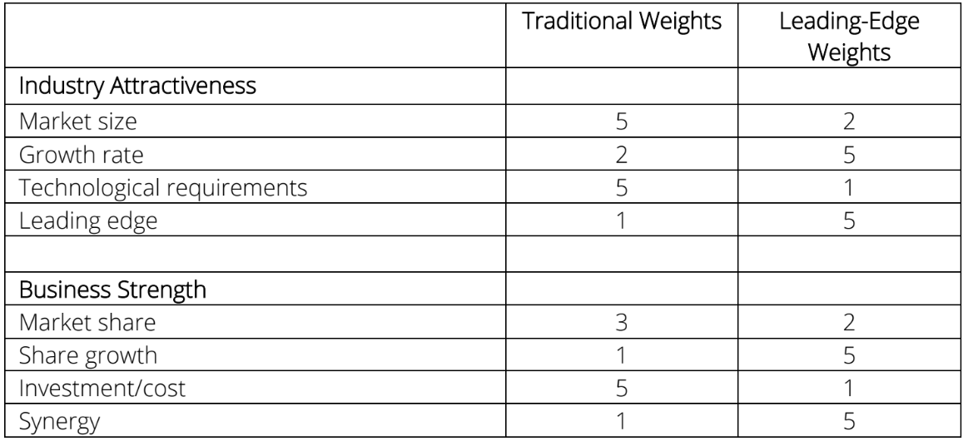
EXHIBIT 1: AWL’s weights for new marketing texts (1:5 scale)

Slide 7
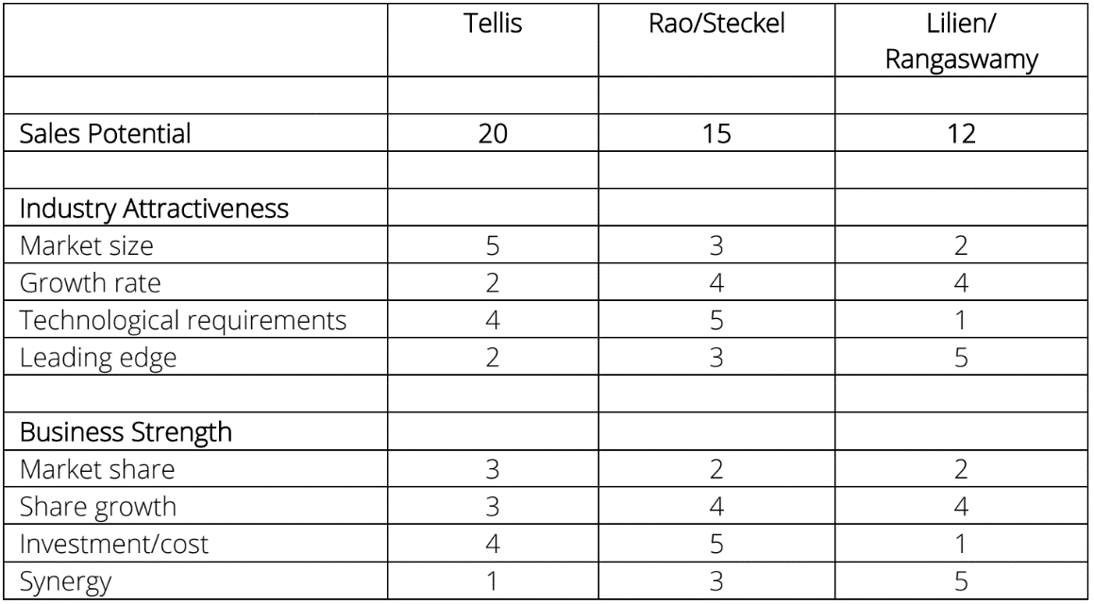
EXHIBIT 2: Ratings for new AWL marketing texts.

Slide 8
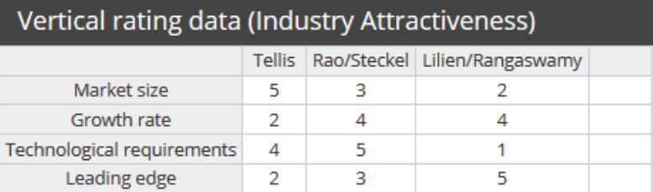
Analytic Background
The richness of the AWL exercise arises from the very different views of a product portfolio in terms of a “Traditional” versus a “Leading Edge” perspective. This indicates that the firm must define itself and its goals in order to make disciplined, consistent new product plans. The data from the case look as follows:
*This matrix contains the ratings of each option on each dimesion
underlying the vertical axis.

Slide 9
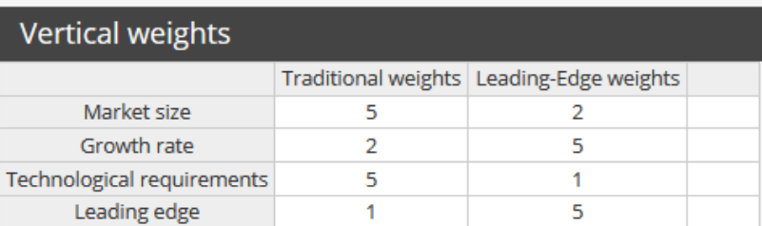
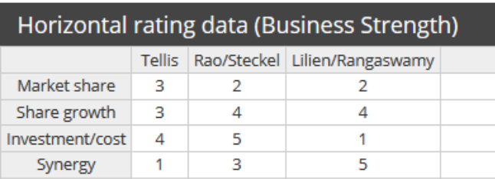
*Weight the importance of each factor by witch the vertical ratings will be
multiplied.
*This matrix contains the ratings of each option on each dimesion
underlying the horizontal axis.

Slide 10
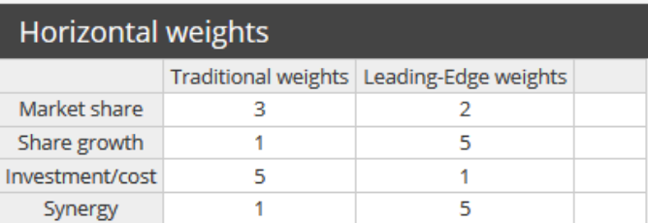
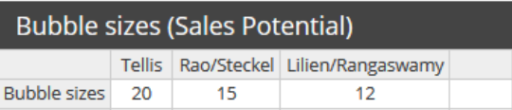
*Weight the importance of each factor by witch the vertical ratings will be
multiplied.
*Specifies the (relative) bubble size to represent each option.

Slide 11
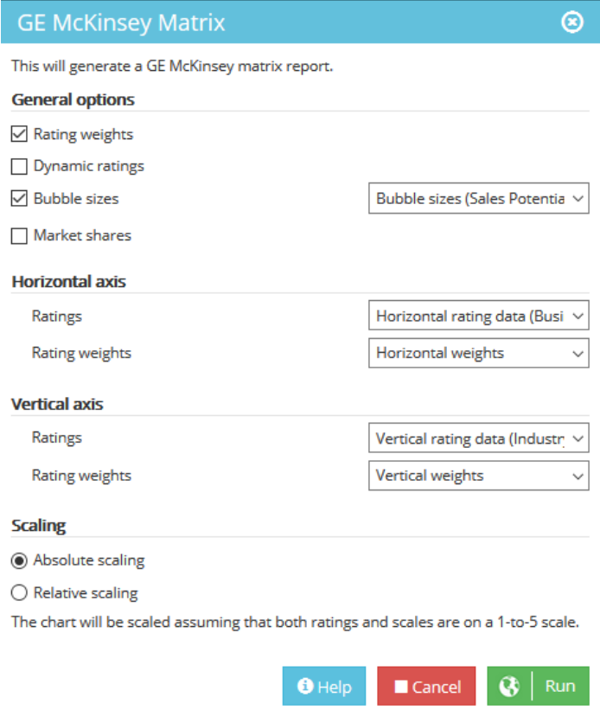
Solution

Slide 12
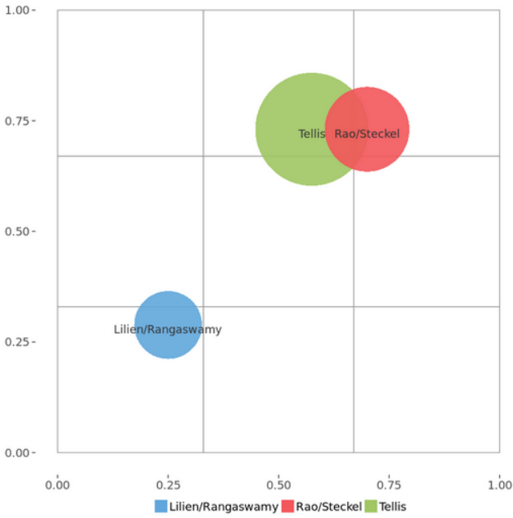
GE/McKinsey matrix: Traditional weights
The above solution setup produces the following charts:

Slide 13
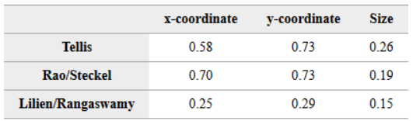
The above solution setup produces the following charts:
Bubbe coordinates in the GE/McKinsey matrix for Traditional weights.

Slide 14
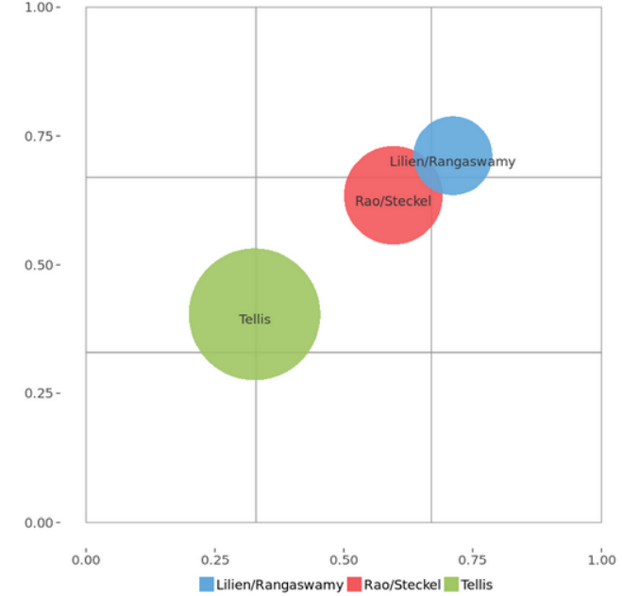
GE/McKinsey matrix: Leading-Edge weights
The above solution setup produces the following charts:

Slide 15
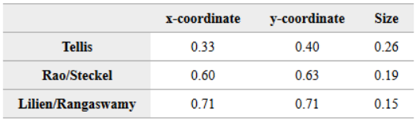
The above solution setup produces the following charts:
Bubbe coordinates in the GE/McKinsey matrix for Leading-Edge weights.

Slide 16
Question 1
Describe the business portfolio and the options available to AWL.

Slide 17
Question 1
Describe the business portfolio and the options available to AWL.
R. The business portfolio of AWL depends on the strategic position of the firm. The firm can either view itself as traditional or leading edge.
The traditional view: Tellis and R&S seem to be the more attractive products, calling for investment in those businesses. AWL should minimize its exposure to the risky L&R book .
The leading-edge view: Tellis has large sales potential so should be supported as part of portfolio. Due primarily to its synergy with the other books, L&R is an attractive candidate for investment. R&S has a similar, attractive position from this perspective.

Slide 18
Question 2
What does the GE approach suggest about the relationship between AWL’s strategic objectives and its promotional plans?

Slide 19
Question 2
What does the GE approach suggest about the relationship between AWL’s strategic objectives and its promotional plans?
R. If AWL views itself as a traditional firm, it might decide to focus on the two more traditional books and minimize its exposure to the new acquisition.
But if AWL views itself as leading edge, it might invest in building a market for the L&R book, using its long-term potential and sales synergy to help develop expertise in new arenas.

Slide 20
Question 3
What should Mark do?

Slide 21
Question 3
What should Mark do?
R. Most students will suggest taking the leading-edge approach. They should be pressed to answer what they would do if it were their money (i.e., if they had stock in AWL). Many will then hedge, showing how difficult the choice of a strategic posture is to the company.

Slide 22
Question 4
What other considerations emerge in allocating the budget in this setting?.

Slide 23
Question 4
What other considerations emerge in allocating the budget in this setting?
R. The firm’s capabilities are critical here and the fit between the product and the expertise of the sales force may force decisions that are not necessarily best for the long-term success of the firm.
Also, the firm may decide that it may even be willing to take a loss on the L&R product to gain expertise in the book/software business.

Slide 24
Question 5
Comment on the uses and the limitations of the GE model.

Slide 25
Question 5
Comment on the uses and the limitations of the GE model.
R. The evaluation of the portfolio is based on a limited number of factors adopted by AWL and on judgmental (subjective) weights by only one or two decision makers. There is no clear link between this portfolio and a financial model of the firm.
The products are defined separately so that the performance of one does not affect the performance of another.

Slide 26


Marketing
Analytics
MIAD
Maestría
en Inteligencia Analítica de Datos

